Slide 1
The role of TLR9 signalling in CLL migration and Ibrutinib resistance. Andrea Pepper

Slide 2
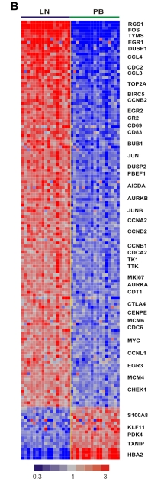
The lymph node microenvironment promotes B-cell receptor signaling, NF- B activation, and tumor proliferation in chronic lymphocytic leukemia
Yair Herishanu,1 Patricia Pe ́rez-Gala ́n,1 Delong Liu,2 Ange ́lique Biancotto,3 Stefania Pittaluga,4 Berengere Vire,1 Federica Gibellini,1 Ndegwa Njuguna,1 Elinor Lee,1 Lawrence Stennett,1 Nalini Raghavachari,5 Poching Liu,5 J. Philip McCoy,3 Mark Raffeld,4 Maryalice Stetler-Stevenson,4 Constance Yuan,4 Richard Sherry,6 Diane C. Arthur,4 Irina Maric,7 Therese White,8 Gerald E. Marti,9 Peter Munson,2 Wyndham H. Wilson,9 and Adrian Wiestner1
1Hematology Branch, National Heart, Lung and Blood Institute (NHLBI), National Institutes of Health (NIH), Bethesda, MD; 2Mathematical and Statistical Computing Laboratory, Division of Computational Biosciences, Center for Information Technology, NIH, Bethesda, MD; 3Center for Human Immunology, NIH, Bethesda, MD; 4Laboratory of Pathology, National Cancer Institute (NCI), Bethesda, MD; 5Bioinformatics Core, NHLBI, NIH, Bethesda, MD; 6Surgery Branch, NCI, Bethesda, MD; 7Department of Laboratory Medicine, Clinical Center, NIH, Bethesda, MD; 8Center for Cancer Research, NCI, Bethesda, MD; and 9Center for Biologics Evaluation and Research, US Food and Drug Administration, Bethesda, MD
Herishanu et al BLOOD 2011

Slide 3
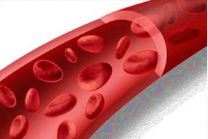
CLL is a multi compartment disease
Lymph-node:
Interactions with DC and T cells
Proliferation
Protective niche
Egress
Ingress
Peripheral blood:
No proliferation
Less protective
Herishanu et al 2011
Patten et al 2008
Buggins et al 2010
Pasikowska et al 2016

Slide 4
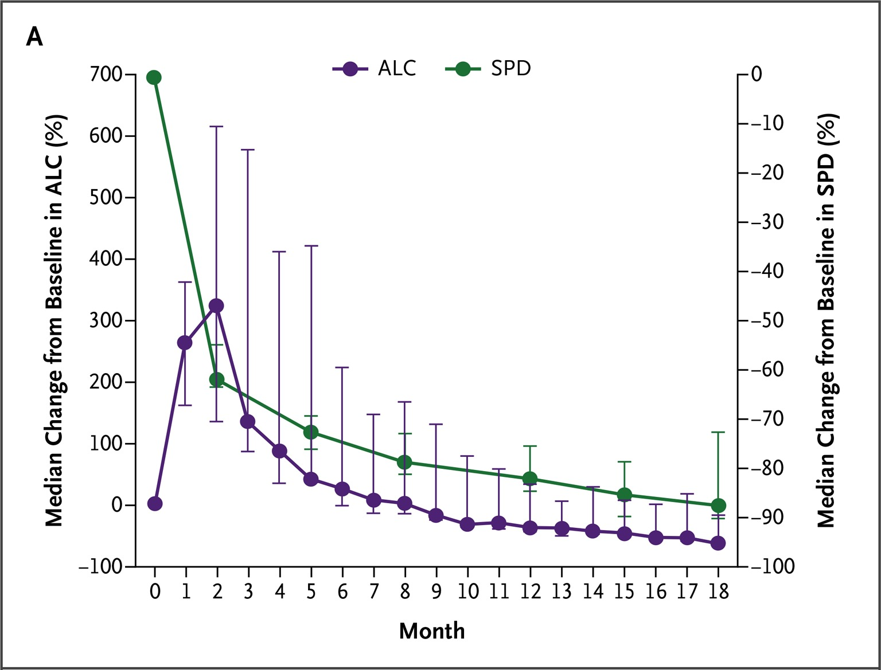
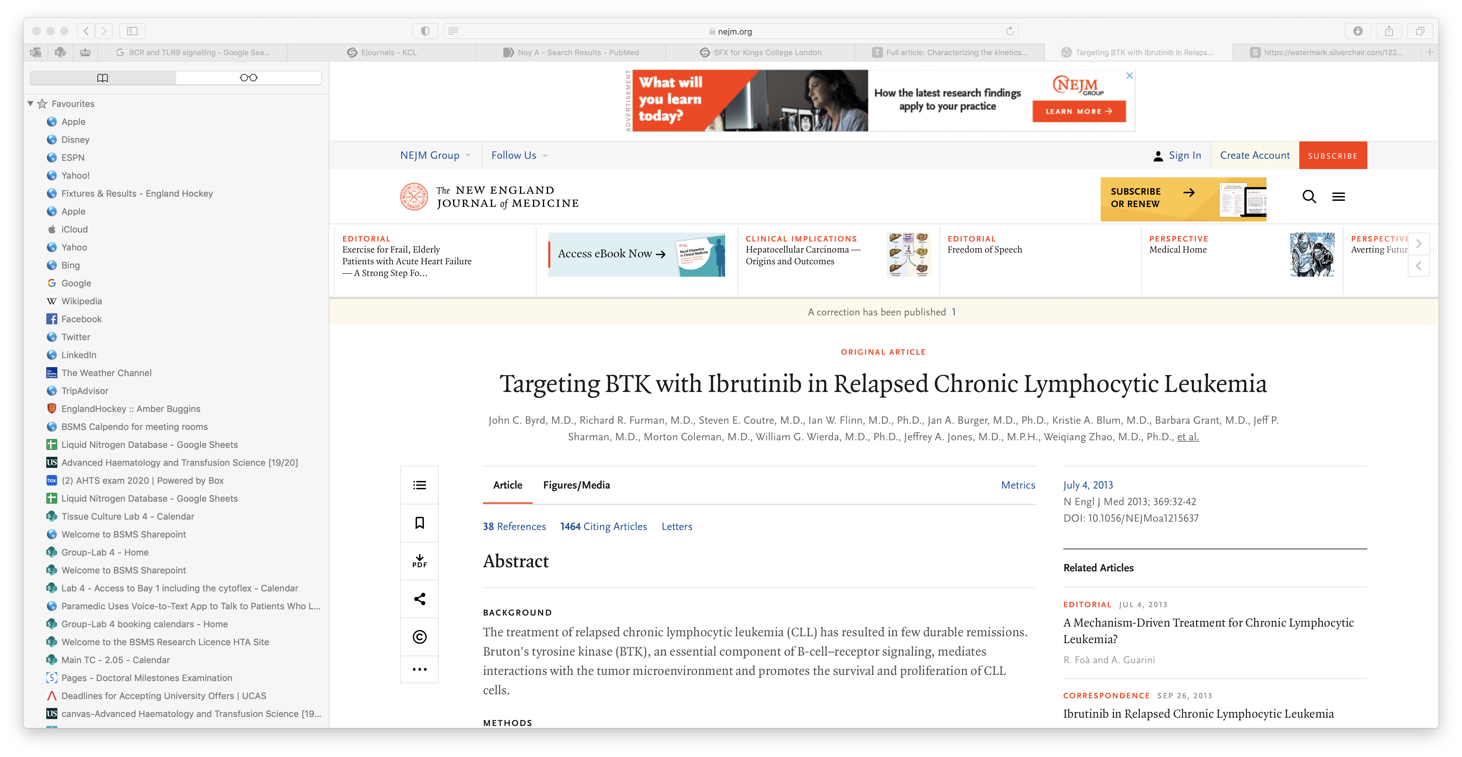
Drug induced clearance of CLL cells from the LN: Response to Ibrutinib over time.

Slide 5
Circulating system to look at CLL cell migration
Migrated CLL cells (port A)
CLL cells
Non-migrating CLL cells (port B)
Cell collection ports
Endothelial cell lined hollow fibers through which cells can migrate
Peristaltic
pump
Reservoir of CLL cells
Walsby et al, BLOOD 2014

Slide 6
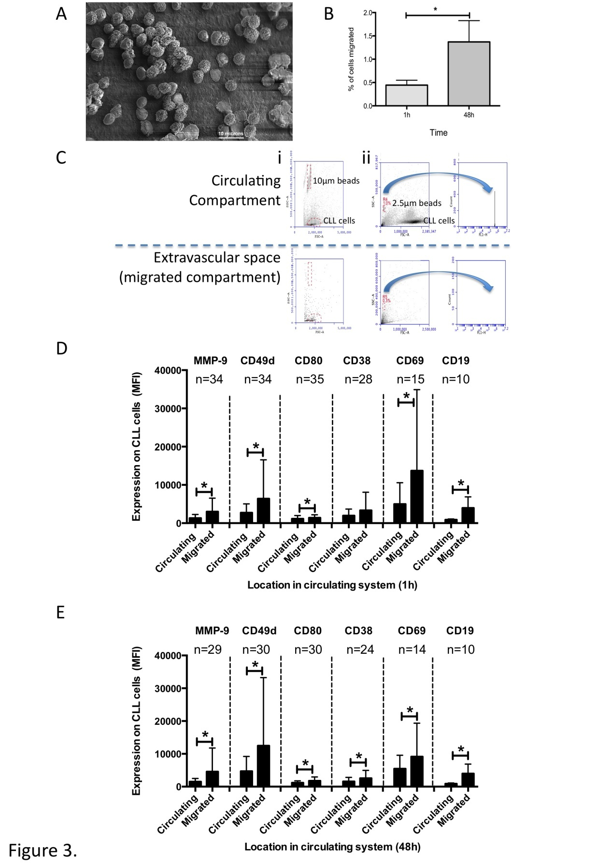
CLL cells actively migrate into the ‘extravascular’ space
Walsby et al, BLOOD 2014

Slide 7
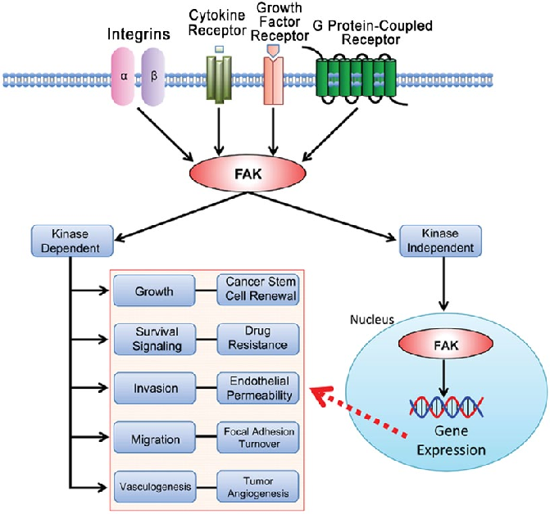
FAK related genes are up-regulated in migrated CLL cells
Adapted from: Toon et al. ACTA HISTOCHEM CYTOC
63(2) (2014)
Burley et al, Cancers 2022

Slide 8
Defactinib inhibition of FAK reduces CLL cell invasion.
Burley et al, Cancers 2022

Slide 9
Toll like receptor and B-cell receptor signaling
TLRs
BCR
TLR2
TLR4
CD79a
TLR6
TLR5
CD79b
Cell
membrane
TLR8
TLR3
BLNK
BTK
TLR-Pathway
LYN
SYK
PLGC
TLR9
TLR7
BCR-Pathway
CARD11
MyD88
MALT1
BCL10
IRAK1
IRAK4
TRAF6
FAK
NF-𝛋B
Cell proliferation
Migration
Survival
IL-6
IL-10
JAK
STAT
Adapted from: Akhter et al. Journal of Neuro-oncology 121, pages 289–296 (2015)

Slide 10
TLR9 induced up-regulation of pSTAT3 and p-P65 NF-𝛋B
in the presence of autologous plasma.
Kennedy et al, BLOOD 2021

Slide 11
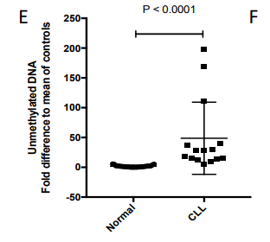
Patients with CLL have higher levels of unmethylated
mitochondrial DNA.
Unmethylated mtDNA was 28.1-fold higher in CLL patients relative to healthy controls
Unmethylated mtDNA
(relative to healthy controls)
Lakis Liloglou
Kennedy et al, BLOOD 2021

Slide 12
Raised levels of cell-free DNA is associated with CLL cell activation, proliferation and poor prognosis.
Kennedy et al, BLOOD 2021

Slide 13
TLR9 stimulation of CLL cells induces phosphorylation of STAT3, NF-𝛋B and FAK.
No change
Kennedy et al, BLOOD 2021 and Burley et al, Cancers 2022

Slide 14
TLR9 stimulation of CLL cells can induce migration.
In-vitro migration
Kennedy et al, BLOOD 2021

Slide 15
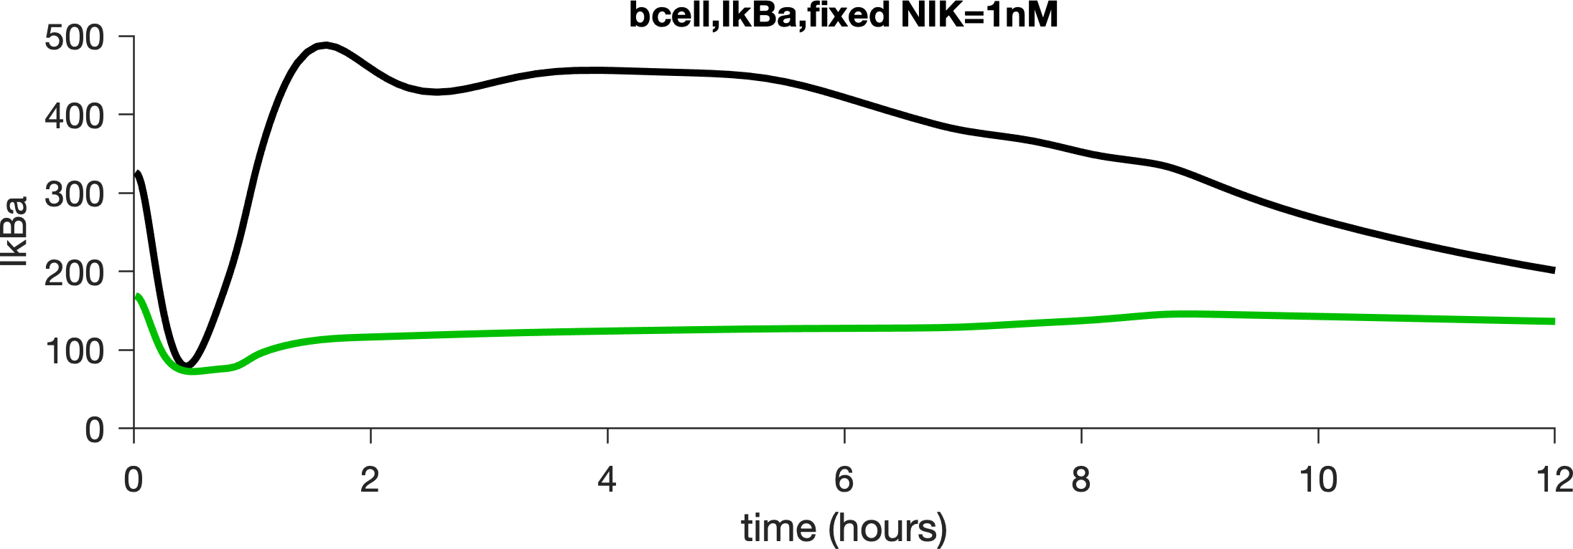
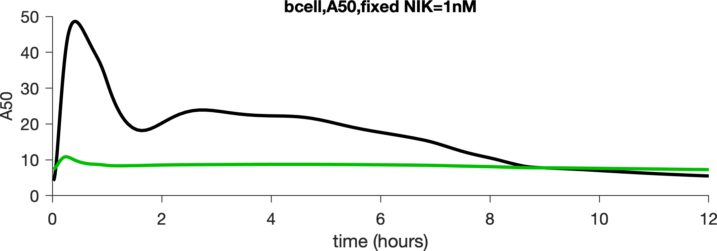
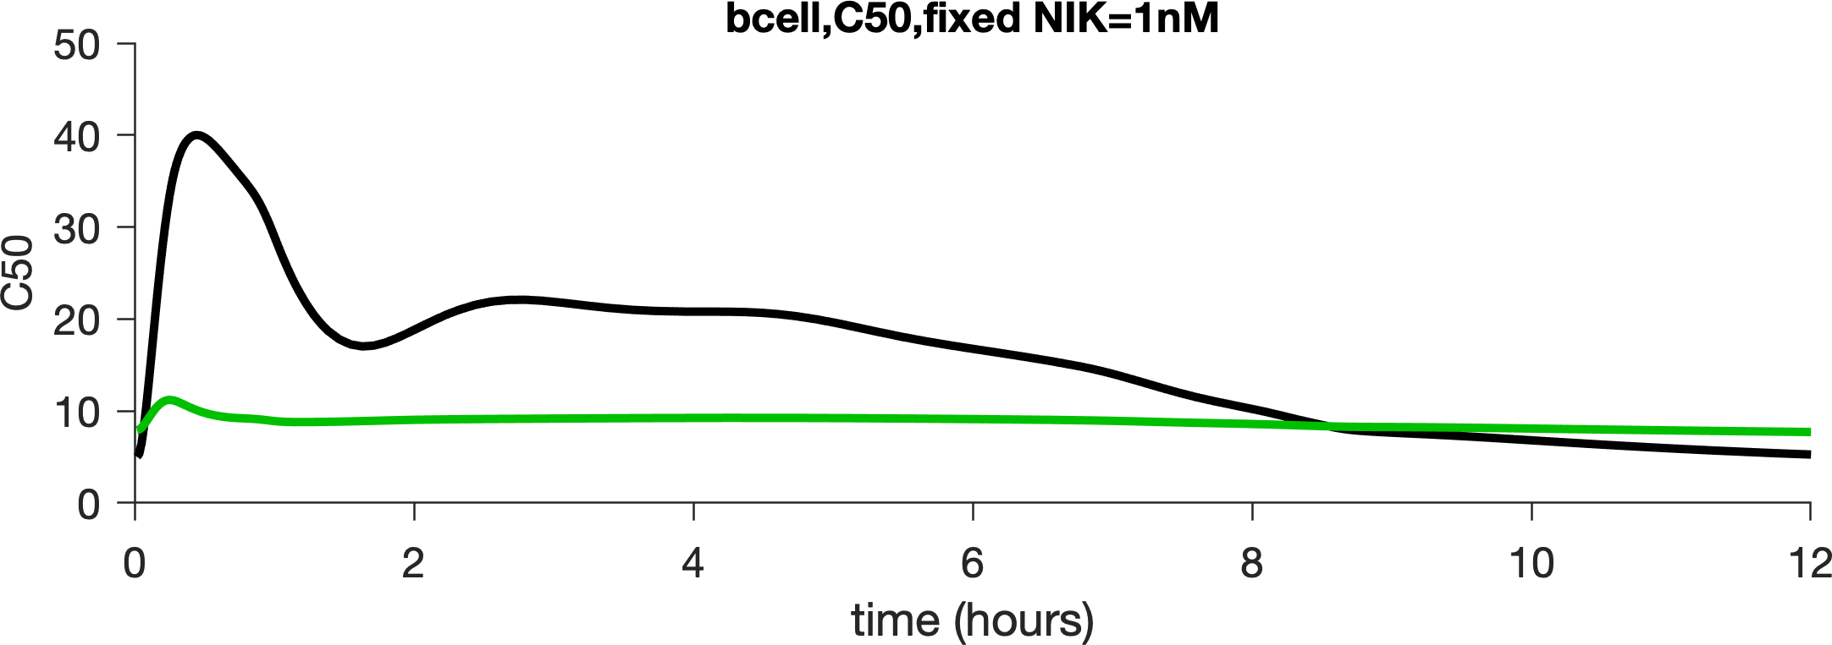
Mathematical modeling of TLR9 stimulation of
M-CLL and U-CLL cells
U-CLL (elevated basal BCR)
M-CLL
TLR9 Simulation (nM)
500
400
IκB⍺
300
200
100
Canonical
0
50
40
NF-𝛋B dimers
RelA:p50
30
20
10
Non-responders
0
50
40
cRel:p50
30
20
10
0
Unpublished data: Simon Mitchell

Slide 16
A dichotomic response both between M-CLL and U-CLL cells and within U-CLL
BCR-BTK
+
TLR9
=
NF-κB
1. M-CLL
TLR9-Ibrutinib sensitised
2. U-CLL
TLR9-non-responder
3. U-CLL +
BTK inhibition
Unpublished data: Simon Mitchell and Emma Kennedy

Slide 17
Two distinct patterns of responses to TLR9 stimulation
TLR9
Unpublished data: Emma Kennedy

Slide 18
Inhibition of TLR9 and BTK is synergistic: migration
Kennedy et al, BLOOD 2021

Slide 19
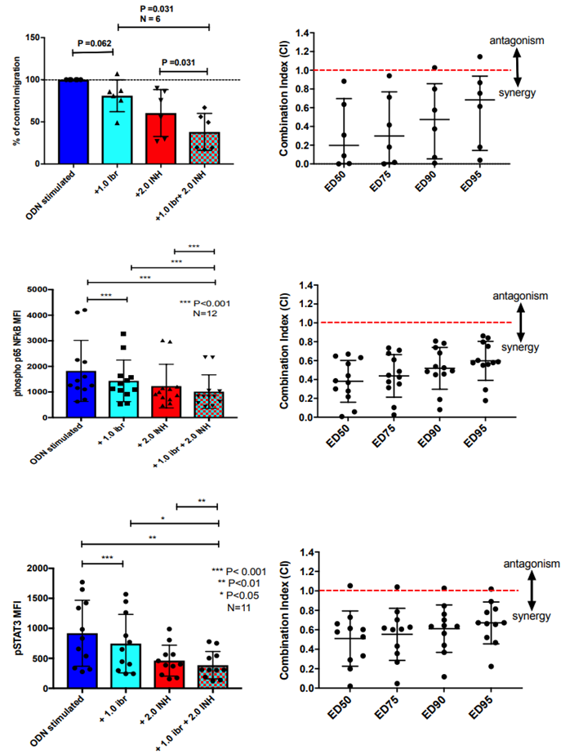
Inhibition of TLR9 and BTK is synergistic: pNF-κB and pSTAT3
Phospho p65 NF-κB
pSTAT3
Combination Index (CI)
Combination Index (CI)
Kennedy et al, BLOOD 2021

Slide 20
Inhibition of FAK and BTK is synergistic: migration
Burley et al, Cancers 2022

Slide 21
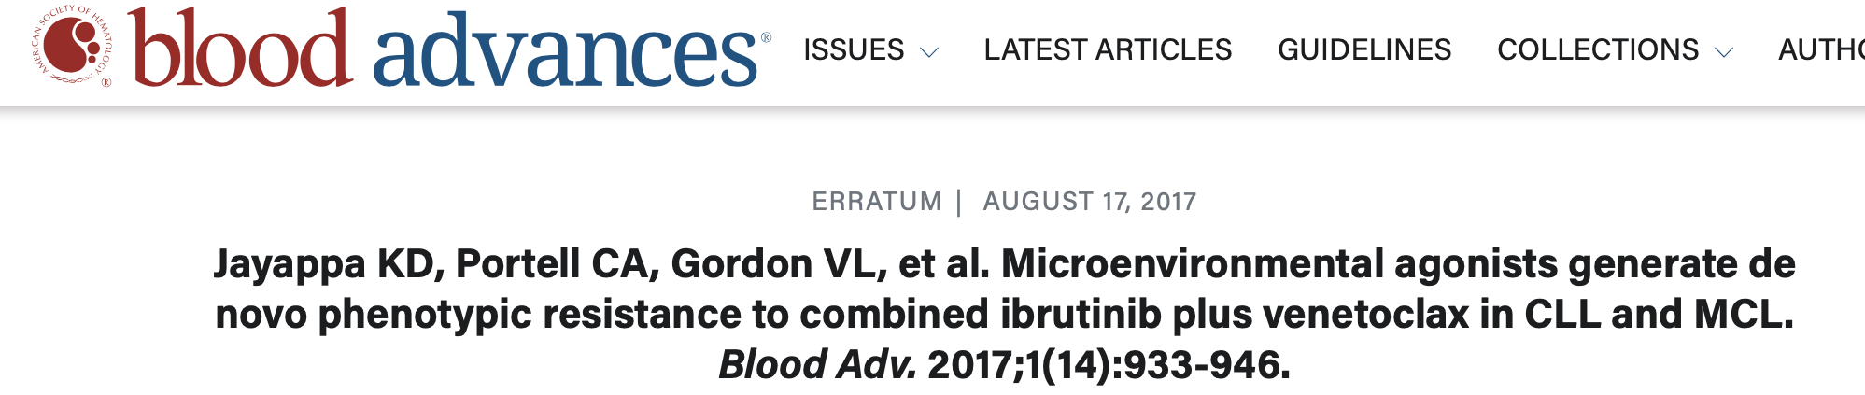
Activation of TLR9 increased NF-κB activation leading to enhanced expression of the anti-apoptotic proteins MCL-1, Survivin and BCL-X_{L}
Decreased dependence on BCL-2 and a resistance mechanism to Ibrutinib + Venetoclax

Slide 22
Toll like receptor and B-cell receptor signaling
TLRs
BCR
TLR2
TLR4
CD79a
TLR6
TLR5
CD79b
Cell
membrane
TLR8
TLR3
BLNK
BTK
TLR-Pathway
LYN
SYK
PLGC
TLR9
TLR7
BCR-Pathway
CARD11
MyD88
MALT1
BCL10
IRAK1
IRAK4
TRAF6
Cell proliferation
Migration
Survival
(BCL-2, MCL-1, BCL-X_{L}, Survivin)
FAK
NF-𝛋B
IL-6
IL-10
JAK
STAT

Slide 23
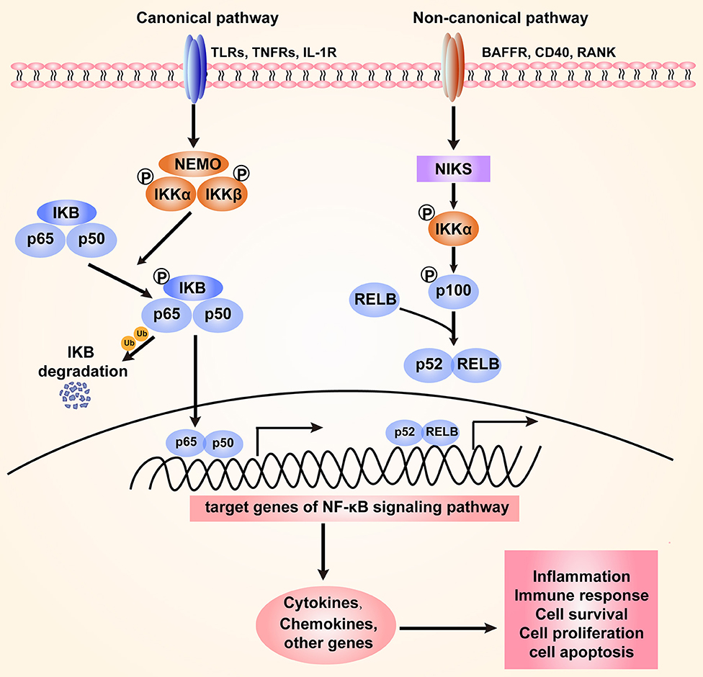

Targeting NF-𝛋B
, BCR
Adapted from: Peng et al. Front. Immunol., 30 June 2020

Slide 24
Inhibition of NIK reduces migration of
CLL cells
Unpublished data: Iona Ashworth and Chris Pepper

Slide 25
CLL cells are more susceptible to NIK Inhibition than normal lymphocytes
Burley et al, Cancers 2022

Slide 26
NIK Inhibition is more effective than Venetoclax in a model of the CLL microenvironment
NIK inhibitor
Venetoclax
Burley et al, Cancers 2022

Slide 27
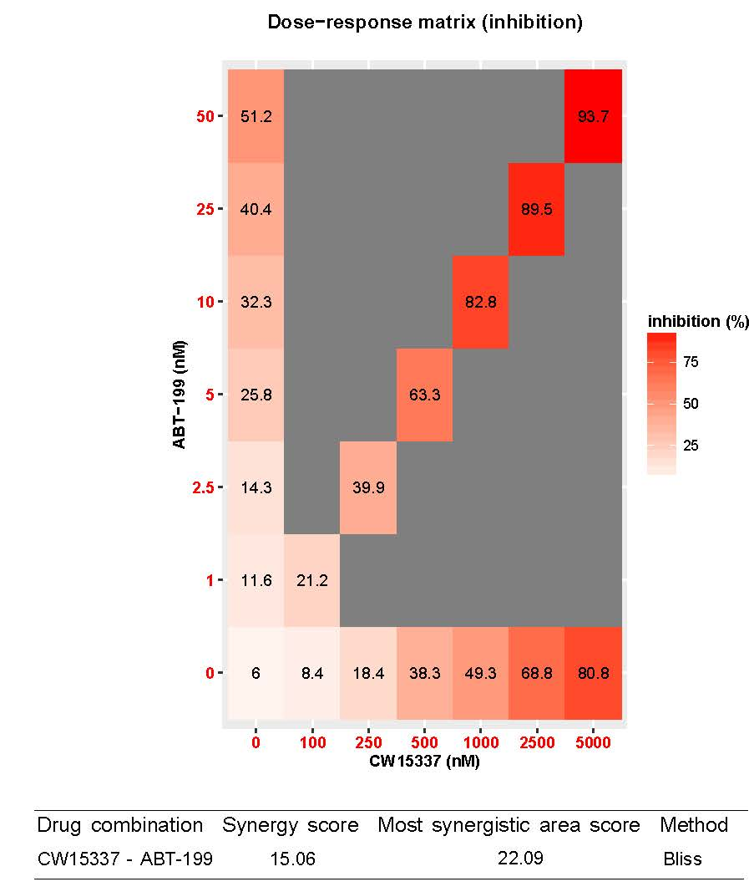
NIK inhibition synergises with Venetoclax
Burley et al, Cancers 2022

Slide 28
Conclusions
Migration of CLL cells is essential for their survival and proliferation.
There are clear transcriptomic differences in FAK and TLR related genes between CLL cells migrate and those that don’t.
TLR9 induced activation of CLL cells is via FAK, NF-κB and STAT3 and results in increased tumor cell migration.
There is a differential response to TLR9 activation both between M-CLL and U-CLL cells and within the U-CLL population.
TLR9 signaling is a potential resistance mechanism to BTK inhibition but dual targeting of the BCR and TLR9 pathways is synergistic.
Targeting NIK inhibits migration and has the potential to synergise with venetoclax to kill lymph node resident CLL cells.

Slide 29



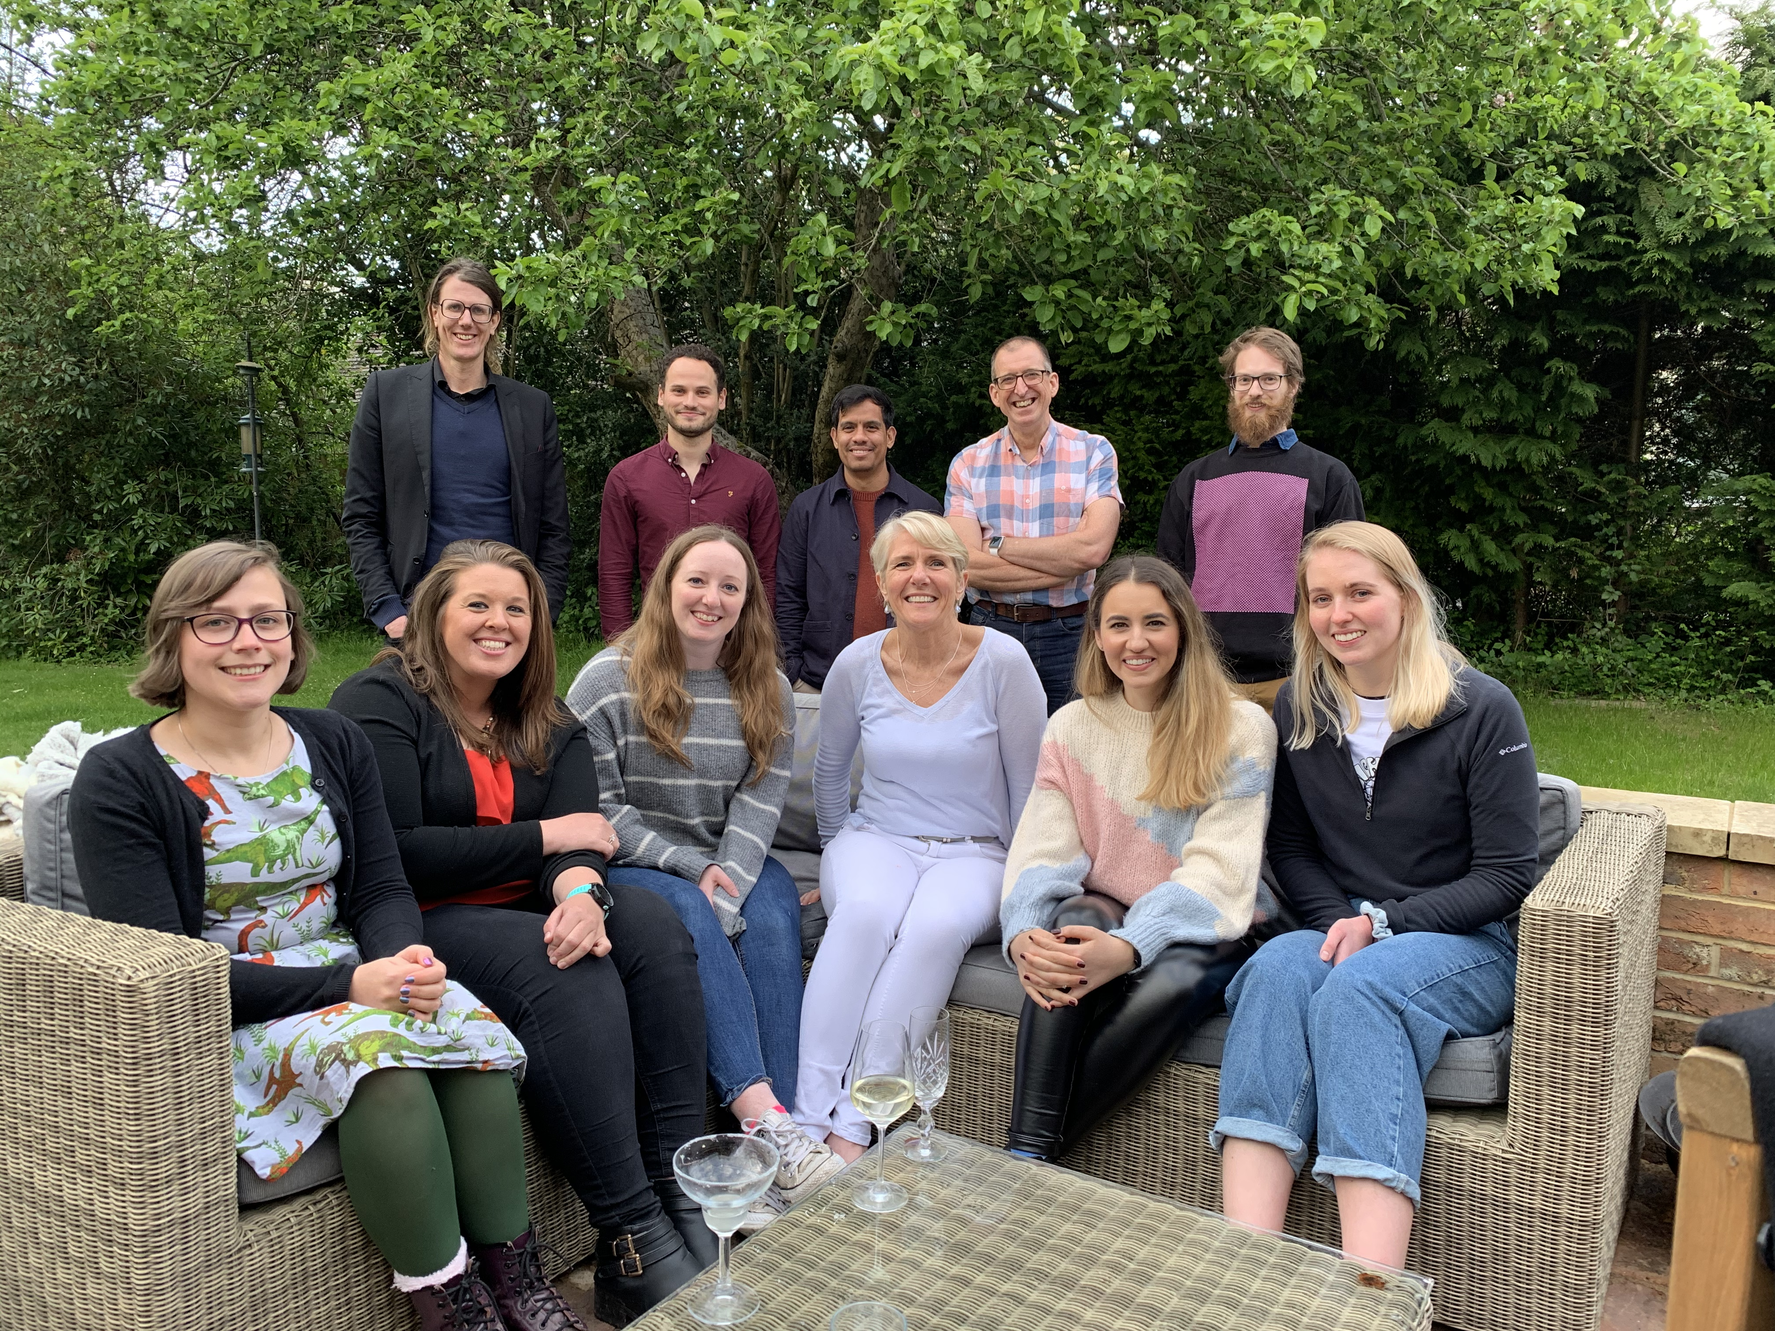

Simon
Tom
&
Emma
Brighton and Sussex
Medical school
Chris Pepper
Emma Kennedy
Tom Burley
Simon Mitchell
Eleni Ladikou
Kim Sharp
Tim Chevassut
Iona Ashworth
Gemma Hamilton
BSUHT
Roz Johnston
Kat Chamberlain
Dora Bak Blaz
University of Cardiff
Beth Walsby
Chris Fegan
Chris
KCL/KCH
Marta Pasikowska
Emma Halliwell
Steve Devereux
Barnaby Clark
Barts Cancer Institute
Eve Coulter
Josep Carreras Leukaemia
Research Institute
Nuria Profitos-Peleja
University of Brighton
Andrew Hesketh
Giselda Bucca
Colin Smith
University of Birmingham
Tanja Stankovic
Angelo Agathanggelou
Ceri Oldreive
Nicholas Davies
University of Liverpool
Triantafillos Liloglou
German Cancer Research Center
Martina Seiffert
Ralph Schulz
University of Strathclyde
Simon Mackey
Thank you to all the patients that donated blood

